Slide 1
Live Test Results and Processing
5/30/2017

Slide 2
Experiments
Dry run
No rat
Pink noise 200ms, 1s intervals
(Pink noise activates the largest cortical area)
20 repetitions
5 power levels -120, 0, 5, 10, 15 dB
Rat
Pink noise 300ms, 1s intervals
40 repetitions
7 power level -120, -15, -10, -5, 0, 5 dB
Tones 1kHz-16kHz in ⅓ octave intervals
50ms, 250ms intervals
-120, -15, -10, -5, 0, 5 dB

Slide 3
Data processing steps
Decimate (factor of 48) with anti-aliasing filter-> sampling frequency 1017 Hz
Lowpass to 300Hz, highpass 0.2Hz
Notch filter at 60, 120, 180, 240, 300 Hz
Epoch into trials
Average across trials with same treatment level
Compare similar treatments between dry run and live test to check for response

Slide 4
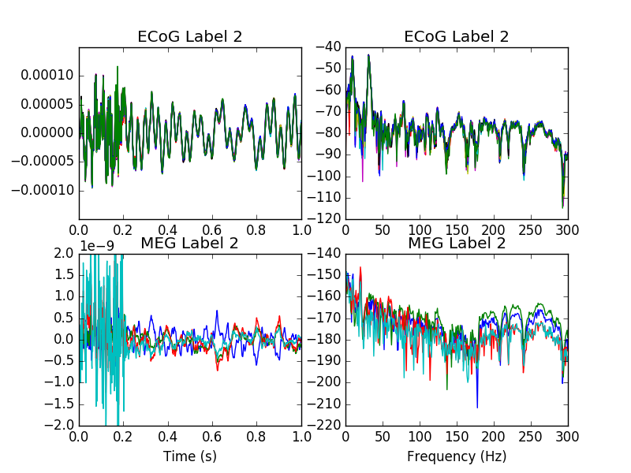
No rat, 5dB pink noise

Slide 5
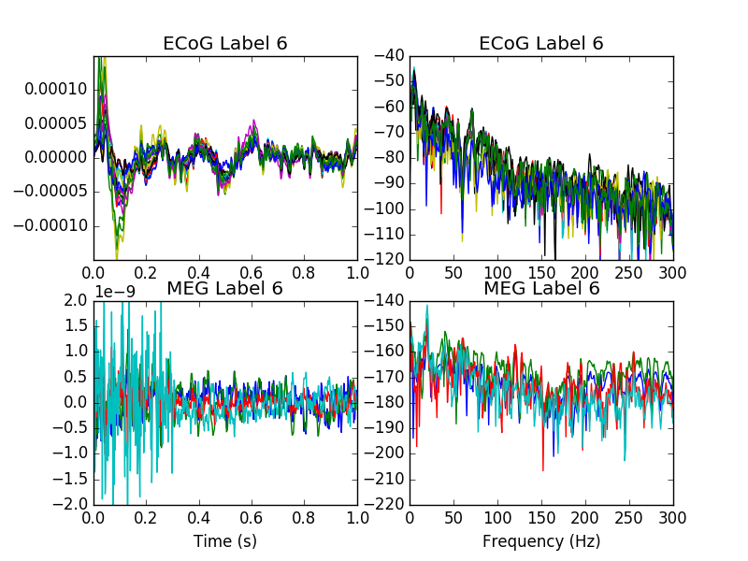
Response
Rat, 5dB pink noise

Slide 6
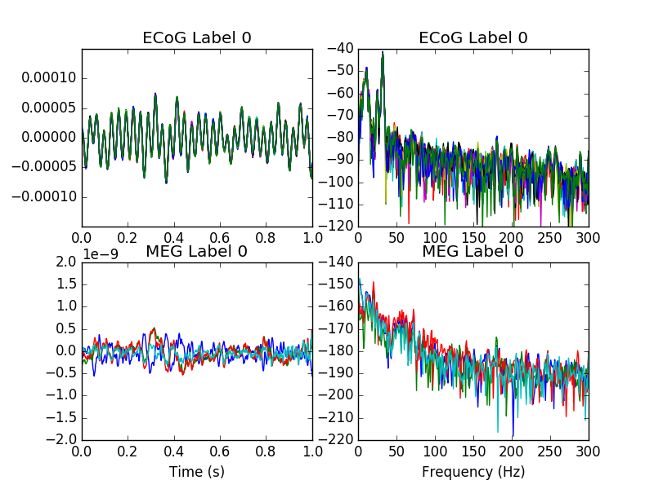
No rat, -120dB pink noise (silence)

Slide 7
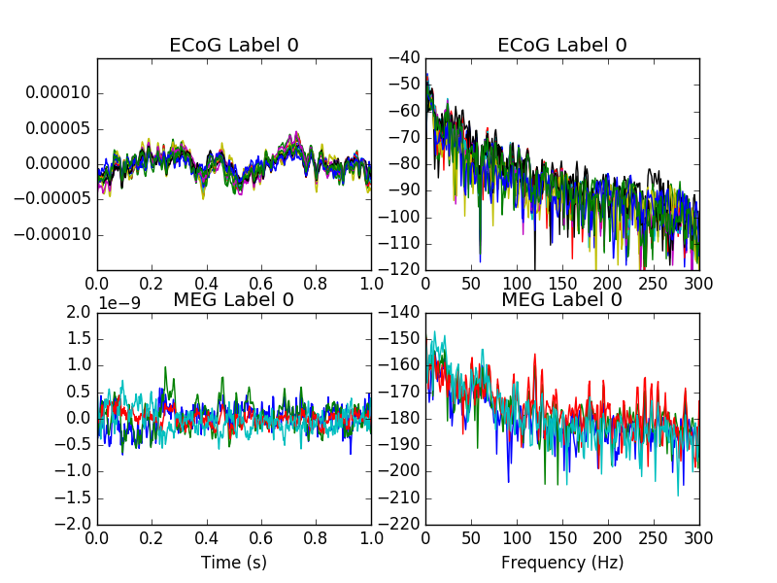
Rat, -120dB pink noise (silence)

Slide 8
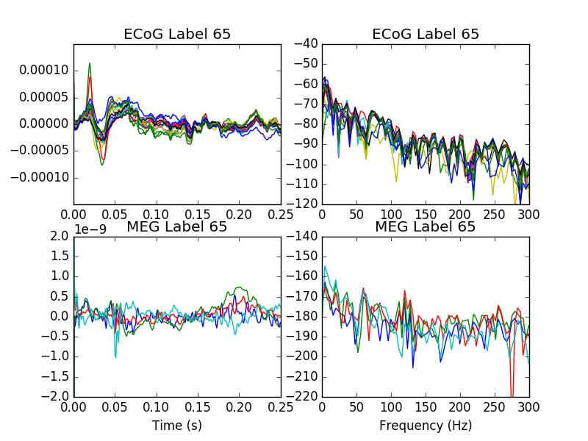
Rat, 5dB 1kHz

Slide 9
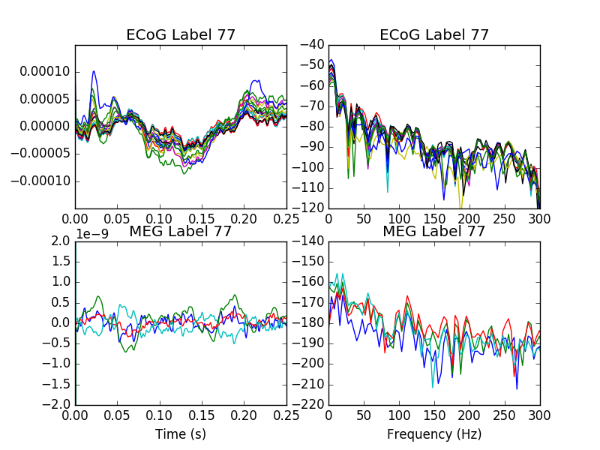
Response on different electrode with different tone; auditory cortex is tonotopic
Rat, 5dB 16kHz

Slide 10
NN evaluation
If we train and test using real data, the results are artificially good, because the resolution of the ECoG is so high (750um) and it is a small part of the brain (4x4 sensor grid), so the localization error is also small. It would only be good if the NN distance error (√3 * RMSE) was much less than 750um.
If we train on synthetic data, with a larger, coarser grid, then test with real data, we can get a more realistic estimate of the localization error of the NN, because the model will be trained to consider the entire brain as a possible space for neurons. In this case, the NN distance error should be less than the grid spacing of the synthetic training data (7.5mm on a 2x2x4 grid). However, we need a reliable way to encode the no stimulus condition - it’s basically noise but could be misinterpreted.

Slide 11
NN training curves
Consider:
Train/test on real data
Treat ECoG as a surrogate for dipole current
3 different stimuli sets - Dry run with pink noise (P0), Rat with pink noise (P1), and Rat with tones (Tones)
The following two were train/test on real data
The next two train on synthetic, test on real
The next two train on synthetic, test on real, but threshold ECoG to guard against baseline noise
Distance error > electrode spacing
Further, results are very similar for rat or no rat. This indicates the localization is largely due to the interference from the speaker on the sensors.

Slide 12
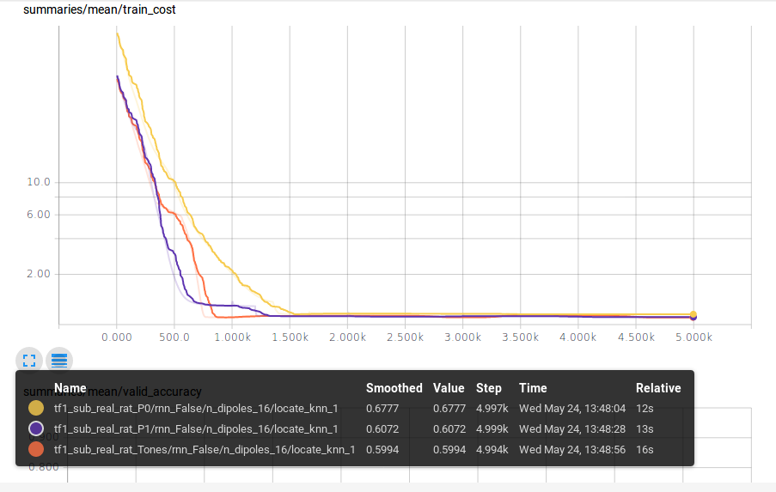

Slide 13
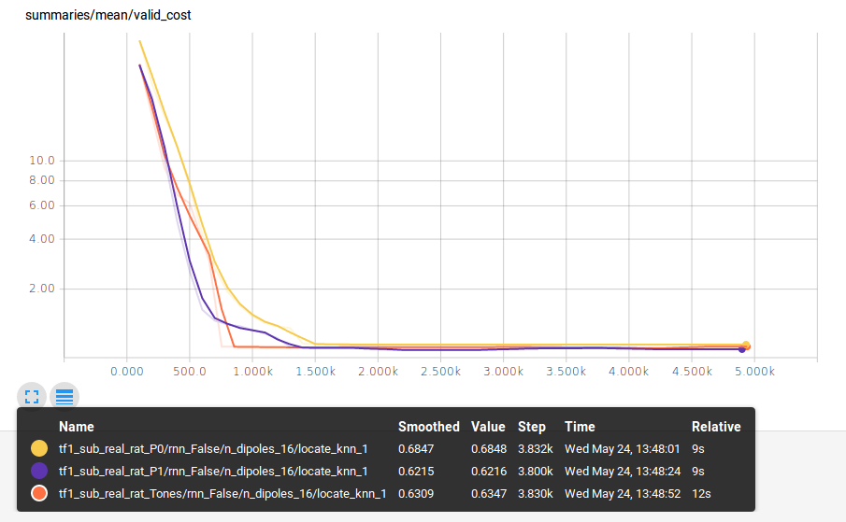

Slide 14
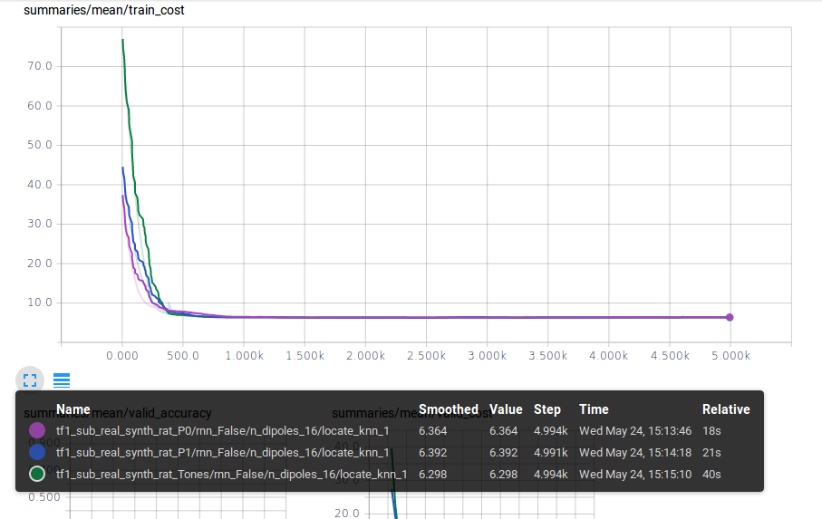

Slide 15
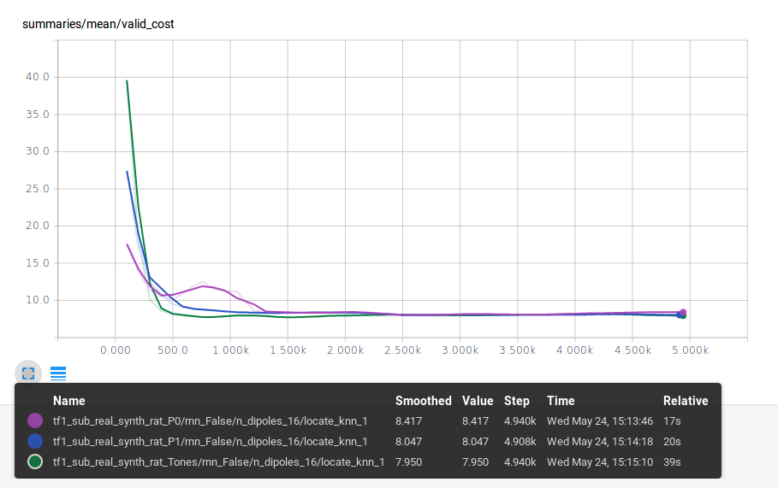

Slide 16
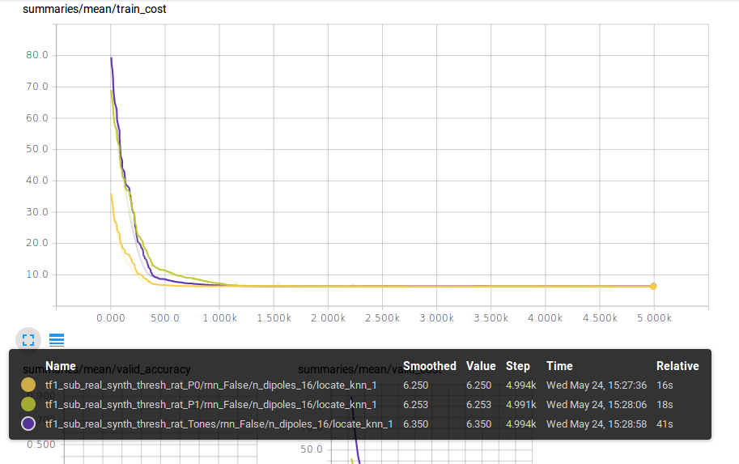

Slide 17
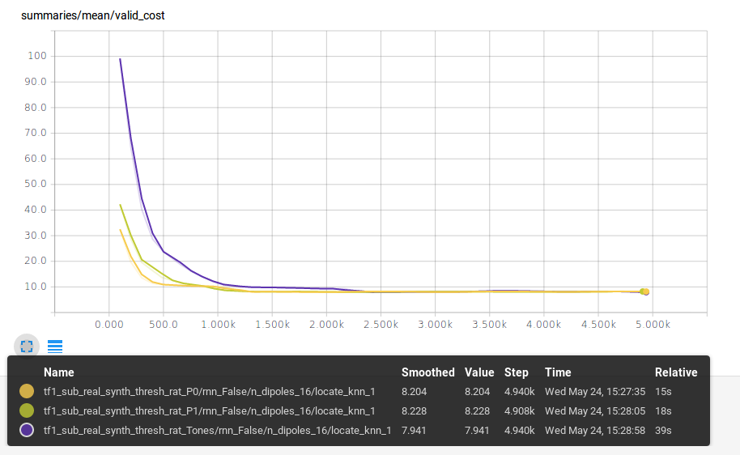

Slide 18
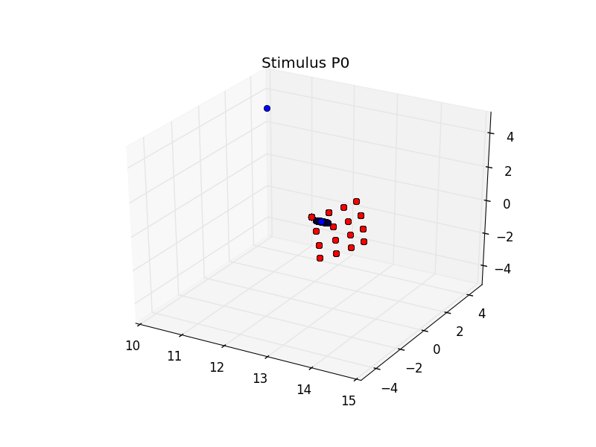
Location estimates for test sets. Essentially the model just gets trained to estimate near the center, because ther sensors provide little information.
Train on real, test on real

Slide 19
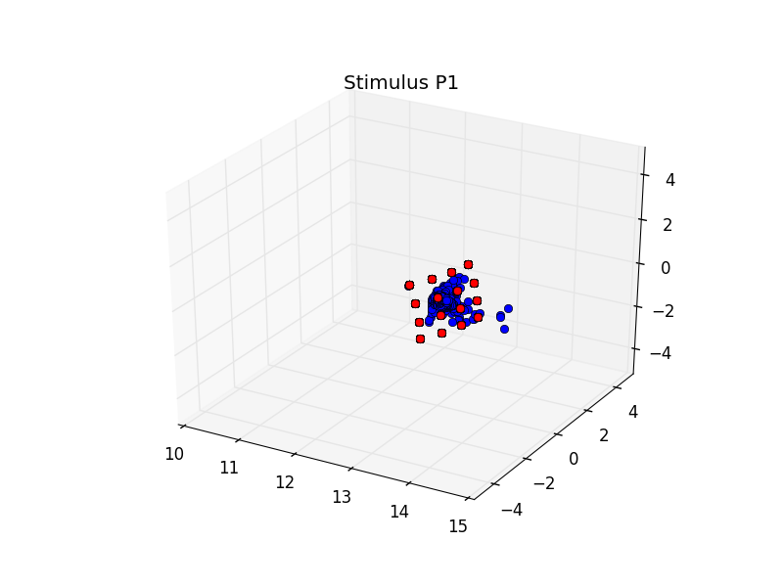
Train on real, test on real

Slide 20
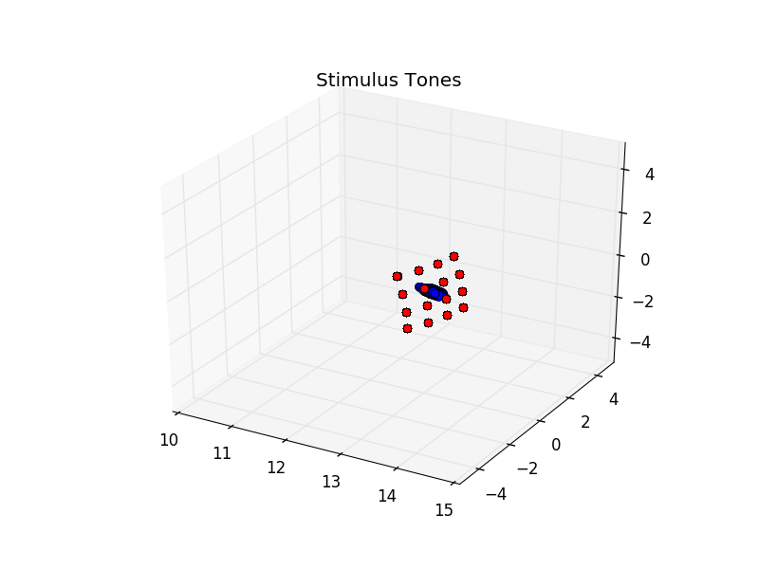
Train on real, test on real

Slide 21
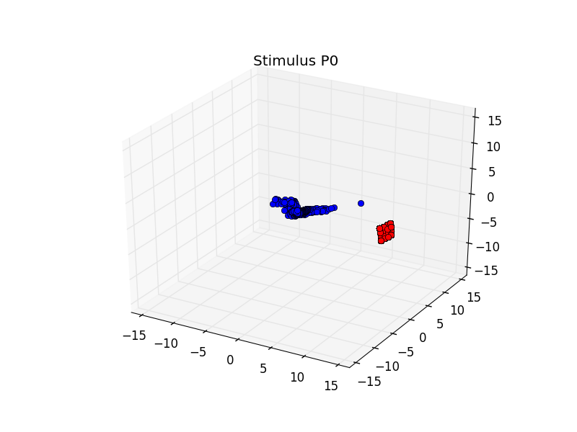
Train on synthetic, test on real

Slide 22
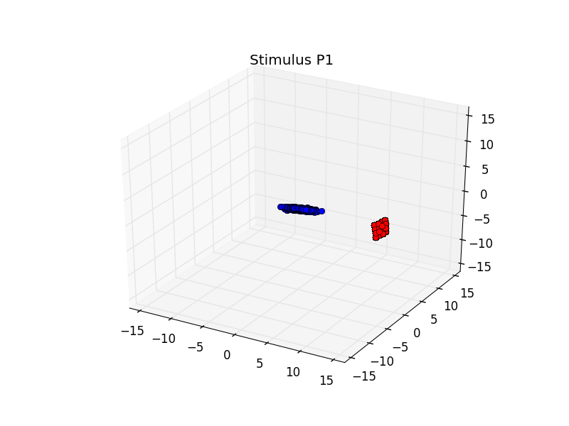
Train on synthetic, test on real

Slide 23
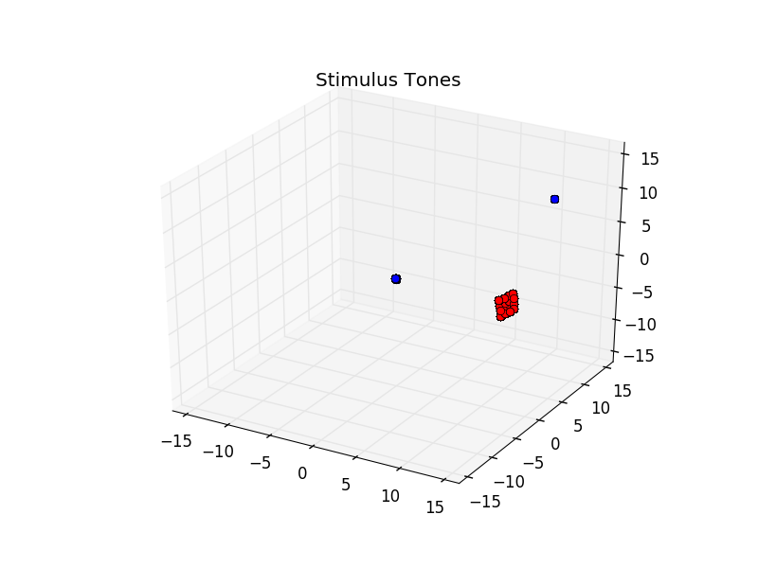
Train on synthetic, test on real

